Slide 1
Bibo Employee Tracking
Keycloak SSO Integration
End-to-End Implementation, Architecture & Verification
POC Status: Successfully implemented and verified

Slide 2
1. Objective
What the integration was designed to achieve
Centralize authentication through Keycloak for the HR application (later we’ll take ERPNext application).
After successful Keycloak login, activate the already-running Bibo Desktop automatically.
Use the same authenticated identity to map the employee to the Bibo backend user.
Allow Bibo Desktop to send activity data without a separate manual Bibo login.
Verify the complete flow from browser login to backend activity synchronization.
Bibo Employee Tracking – Keycloak SSO POC | 2

Slide 3
2. High-Level Architecture
Components used in the local POC
Keycloak
HR Application
Bibo Backend
Bibo Desktop
Identity provider
Realm: master
Client: hr-app
Flask application
Port: 8081
OIDC login + callback
Go + Gin API
Port: 8090
JWT + sync APIs
Tauri/Rust
Local server: 47615
Keycloak
HR App
Bibo Backend
Bibo Desktop
Sync
Database: PostgreSQL 16 (bibo_postgres)
Demo identity: hr-user1@example.com
Demo business: Hawk Demo
Bibo Employee Tracking – Keycloak SSO POC | 3

Slide 4
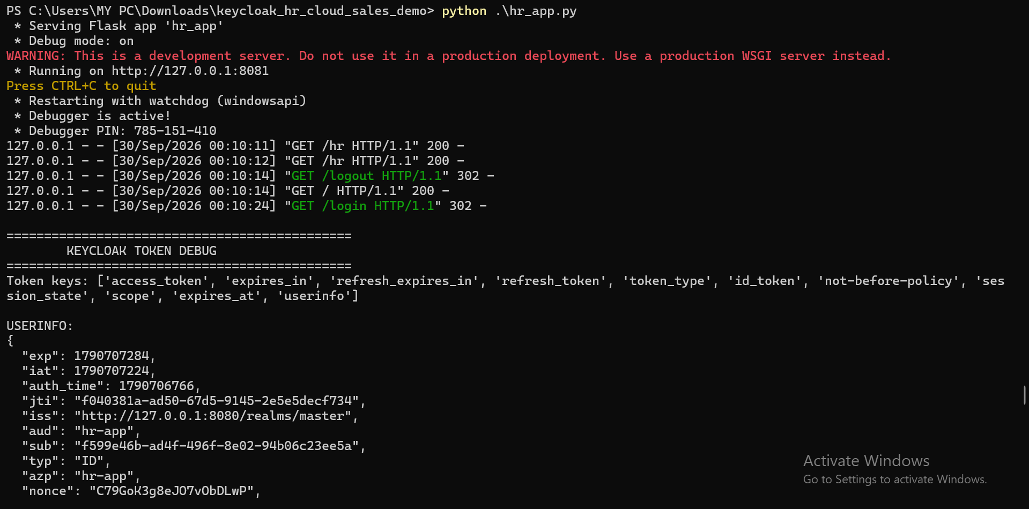
To run application (HR):-cd "C:\Users\MY PC\Downloads\keycloak_hr_cloud_sales_demo"
$env:KEYCLOAK_REALM="master" python .\hr_app.py

Slide 5
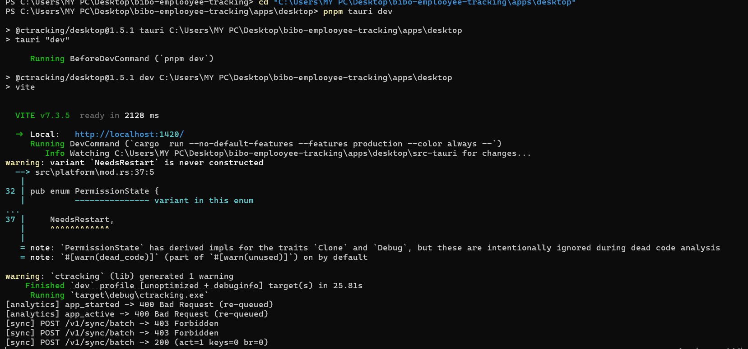
To run Bibo Desktop :-cd "C:\Users\MY PC\Desktop\bibo-emplooyee-tracking\apps\desktop"
$env:CTRACKING_BACKEND_URL="http://127.0.0.1:8090" pnpm tauri dev

Slide 6
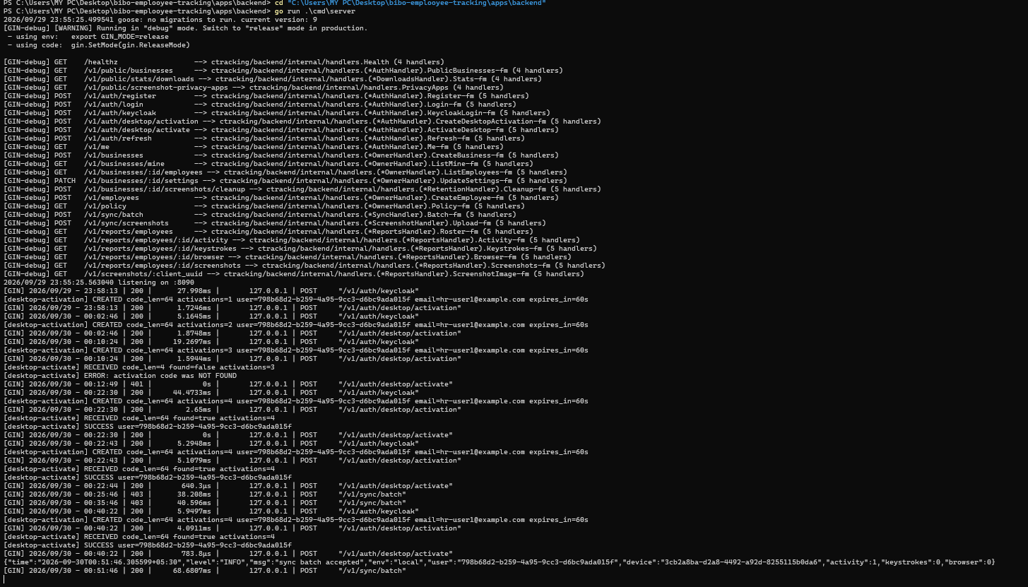
To run Bibo backend:-cd "C:\Users\MY PC\Desktop\bibo-emplooyee-tracking\apps\backend" go run .\cmd\server

Slide 7
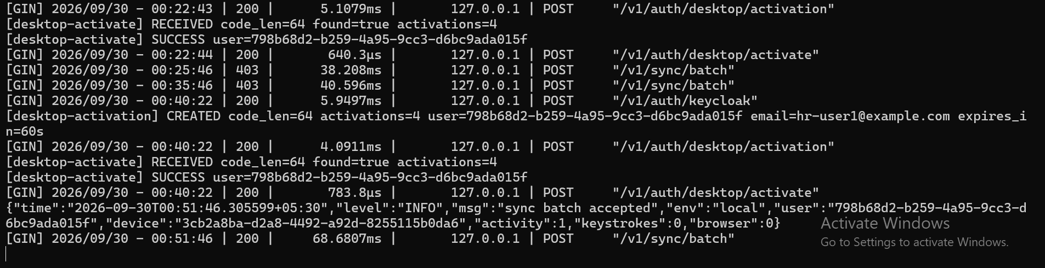
To run Bibo backend (in detail):-cd "C:\Users\MY PC\Desktop\bibo-emplooyee-tracking\apps\backend" go run .\cmd\server

Slide 8
3. Authentication Flow
Keycloak handles authentication; Bibo receives a verified identity
User opens HR
Keycloak Login
OIDC Callback
HR Session
Bibo Activation
User opens the HR application at http://127.0.0.1:8081.
HR redirects the user to Keycloak for login.
Keycloak returns an authenticated OIDC response to /callback.
The HR application validates the identity and obtains the Keycloak ID token.
The HR application sends the ID token to the Bibo backend for identity mapping.
Bibo Employee Tracking – Keycloak SSO POC | 4

Slide 9
4. Automatic Bibo Desktop Activation
Short-lived, one-time activation code
HR App
/desktop/activation
One-time Code
Desktop /activate
Bibo Session
Backend verifies the Keycloak identity and maps the email to the Bibo user.
Backend generates a 64-character random activation code with a 60-second lifetime.
HR finds the running Bibo Desktop local server and sends the code to /activate.
Desktop exchanges the code with the backend and stores the Bibo session.
The activation code is consumed after successful use.
Bibo Employee Tracking – Keycloak SSO POC | 5

Slide 10
5. Identity & Database Mapping
Why the initial sync returned HTTP 403
Keycloak Identity
Bibo User
Business Membership
hr-user1
hr-user1@example.com
ID: 798b68d2-...
Email matches Keycloak
Hawk Demo
Role: owner
Initial state: the Bibo user existed, but the memberships table was empty and no business existed.
Result: /v1/sync/batch returned HTTP 403 because the authenticated user had no business membership.
Fix: created the Hawk Demo business and linked hr-user1 through the memberships table.
After the mapping was created, the desktop session synchronized activity successfully.
Bibo Employee Tracking – Keycloak SSO POC | 6

Slide 11
6. Final End-to-End Flow
Verified local POC sequence
Keycloak Login
HR Auth
Activation
Desktop Session
Business Mapping
Activity Capture
/sync/batch
Backend Accepts
HTTP 200
Authentication, activation, identity mapping, and synchronization were all verified.
Final backend log: “sync batch accepted” for the mapped Bibo user/device.
Final endpoint response: POST /v1/sync/batch → HTTP 200.
Bibo Employee Tracking – Keycloak SSO POC | 7

Slide 12
7. Technical Implementation
Main code and configuration changes
Backend authentication: Keycloak OIDC verifier added using go-oidc.
POST /v1/auth/keycloak validates the Keycloak token and maps the user by email.
Activation endpoints: POST /v1/auth/desktop/activation and POST /v1/auth/desktop/activate.
Desktop client: activate_with_code() exchanges the one-time code and stores the Bibo session.
Desktop local server: /activate route added while existing routes were preserved.
Development backend override: CTRACKING_BACKEND_URL=http://127.0.0.1:8090.
Build verification: Rust desktop cargo check passed; Go backend go build ./... passed.
Bibo Employee Tracking – Keycloak SSO POC | 8

Slide 13
8. Security Design
Controls used in the activation mechanism
OIDC Verification
One-Time Activation
Short Expiry
Keycloak token is verified before creating a Bibo activation code.
Random 32-byte value encoded as 64 hex characters; consumed after use.
Activation code expires after 60 seconds.
Actual activation codes and access tokens were not printed in backend logs.
For production hardening, the local activation endpoint can return only success and keep Bibo tokens entirely local.
Client secrets should be stored as environment variables and rotated if exposed during development.
Bibo Employee Tracking – Keycloak SSO POC | 9

Slide 14
9. Testing & Verification Evidence
What was actually verified
Keycloak
Desktop Activation
Sync
POST /v1/auth/keycloak
HTTP 200
found=true
SUCCESS + HTTP 200
sync batch accepted
HTTP 200
Desktop local server was confirmed running on 127.0.0.1:47615.
Initial sync returned 403 because business membership was missing.
After creating the Hawk Demo business and membership, final sync was accepted.
Final observed data: activity=1, keystrokes=0, browser=0; device ID was recorded.
Conclusion: the complete local POC flow is operational.
Bibo Employee Tracking – Keycloak SSO POC | 10

Slide 15
10. Current Status
Completed vs. follow-up work
COMPLETED / VERIFIED
FOLLOW-UP / PRODUCTION HARDENING
• Keycloak OIDC login
• HR role-based access
• Bibo identity mapping
• One-time desktop activation
• Desktop session storage
• Business + membership mapping
• Activity synchronization
• HTTP 200 final sync verification
• Backend and desktop builds
• Test additional users and roles
• Test logout/session expiry
• Test desktop restart/re-login
• Validate screenshot/browser/keystroke policies
• Move demo DB mapping to provisioning flow
• Avoid returning Bibo tokens from local activation response
• Secure client-secret management
• Add automated integration tests
Bibo Employee Tracking – Keycloak SSO POC | 11

Slide 16
11. Final Outcome
Manager summary
Keycloak is the authentication entry point for the HR application.
Successful Keycloak login generates a short-lived activation code for Bibo Desktop.
Bibo Desktop establishes its authenticated Bibo session without a separate manual Bibo login.
The authenticated user is mapped to a Bibo business membership.
Activity data reaches the backend and the final /v1/sync/batch request returned HTTP 200.
Therefore, the complete local POC — Keycloak → HR → Bibo activation → Bibo session → activity sync — has been implemented and successfully verified.
FINAL STATUS
END-TO-END POC VERIFIED
Bibo Employee Tracking – Keycloak SSO POC | 12

Slide 17
Appendix: Local POC Components
Reference information
Keycloak: http://127.0.0.1:8080
HR App: http://127.0.0.1:8081
Bibo Backend: http://127.0.0.1:8090
Bibo Desktop local server: 127.0.0.1:47615
Database: PostgreSQL 16, container bibo_postgres
Demo user: hr-user1@example.com
Demo business: Hawk Demo
Key endpoints: /v1/auth/keycloak, /v1/auth/desktop/activation, /v1/auth/desktop/activate, /v1/sync/batch
Bibo Employee Tracking – Keycloak SSO POC | 13

